Slide 1
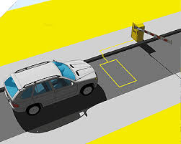
Problem Statement
Vehicle Cut-in Detection
Vehicle cut-in detection is a critical component in advanced driver-assistance systems (ADAS) and autonomous driving technology. This system identifies when another vehicle cuts into the lane in front of the host vehicle, which is essential for maintaining safe following distances and preventing collisions. Combines data from multiple sensors to create a comprehensive understanding of the vehicle's environment . Machine Learning Algorithms: Analyze sensor data to detect patterns and identify potential cut-in scenarios.

Slide 2
Unique Idea Brief (Solution)
MobileNet-SSD (Single Shot Detector) Deep Learning Model
The MobileNet-SSD model is an efficient and lightweight deep learning architecture designed for object detection. It combines the MobileNet architecture, which is optimized for mobile and embedded vision applications, with the Single Shot Multibox Detector (SSD) framework, which allows for real-time object detection. Detects objects in a single forward pass through the network, enabling fast inference speeds.It is designed to be computationally efficient, making it suitable for real-time applications on devices with limited processing power.
Distance Calculation: Computes the distance to the detected object using the bounding box width. Despite its lightweight nature, MobileNet-SSD maintains good detection accuracy, especially for applications requiring real-time performance . The combination of MobileNet's efficiency and SSD's single-shot detection capability allows for real-time object detection on mobile and embedded devices

Slide 3
Features Offered
The MobileNet-SSD (Single Shot Detector) deep learning model is well-suited for vehicle cut-in detection due to its balance of efficiency, speed, and accuracy.
Single Shot Detection: Processes the entire image in a single forward pass, enabling real-time detection of vehicles.
Low Latency: Optimized for quick inference, which is crucial for detecting and reacting to cut-ins promptly.
Multiscale Feature Maps: Detects objects at different scales, which helps in identifying vehicles at varying distances and sizes in the frame.
Default Boxes: Predefined anchor boxes of different shapes and sizes to handle various vehicle dimensions and orientations.
Predictive Modeling: When integrated with predictive algorithms, the model can help foresee potential cut-in maneuvers by other vehicles .
Real-Time Alerts: Generates real-time alerts for the driver or autonomous system to take preventive actions against potential cut-ins .
Fusion with Other Sensors: Can be combined with data from other sensors like radar, lidar, and V2X communication systems to enhance the overall detection and prediction accuracy.

Slide 4
Process flow
Image Acquisition (Capturing a frame from a webcam or reading an image from disk.)
Image Preprocessing(Pixel values are scaled (usually divided by 255) and mean-subtracted to normalize the input data.)
Model Inference(The pre-trained MobileNet-SSD model and its corresponding configuration (prototxt) file are loaded.)
Detection Processing(Extract the bounding boxes, confidence scores, and class IDs for detected objects from the detection results.)
Distance Estimation(Use the known width of the object (e.g., average car width) and the focal length of the camera to estimate the distance from the camera to the object.)
Visualization and Alert Mechanism(Add text overlays to display the class label and confidence score for each detected object.)

Slide 5
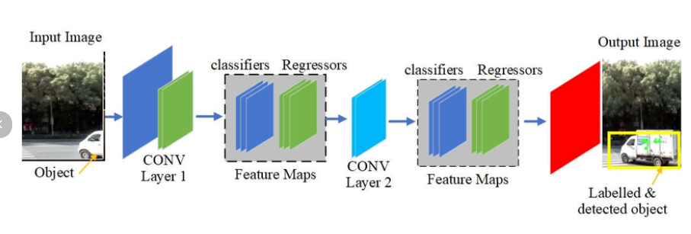
Architecture Diagram
Github link : https://github.com/Kshatri-Sahil/Vehicle-cut-in-detection.git
Video link : https://drive.google.com/file/d/142hk_mhjr8ZGMV1d6lsG2pJ_u51yE_k/view?usp=drive_link

Slide 6

Technologies used
The MobileNet-SSD (Single Shot Detector) model integrates several advanced technologies to enable efficient and accurate vehicle cut-in detection.
Deep Learning Frameworks: Implemented using frameworks like TensorFlow, PyTorch, or Caffe, which provide tools for building and training neural networks.
BlobFromImage: Converts input images into a format suitable for input to the neural network, including resizing, scaling pixel values, and mean subtraction.
Post-processing Step: Filters overlapping bounding boxes to retain the most confident predictions, ensuring accurate detection of individual vehicles.
OpenCV: A powerful computer vision library used for image and video processing, including reading and displaying images and videos, and performing image transformations.
Caffe Model Zoo: Repository of pre-trained models and related files, such as the MobileNet-SSD's prototxt and caffemodel files.

Slide 7
Team members and contribution:
Kshatri Syam sahil singh – Coding , software , report
Chukka Chaitanya – Coding , Software
Varshini S – Coding , Report
Chava Likhith – Coding , Software
Scope of Improvement in Vehicle Cut-In Detection :
Combining MobileNet-SSD with other models, such as recurrent neural networks (RNNs) or long short-term memory (LSTM) networks, to better understand temporal sequences and improve predictions of vehicle movements.
High-Quality Datasets: Training the model on larger and more diverse datasets to improve its ability to generalize across different environments, weather conditions, and lighting scenarios.

Slide 8
Conclusion
Vehicle cut-in detection is a vital technology in modern vehicles, enhancing safety and driving experience. By combining advanced sensors, machine learning algorithms, and real-time processing, these systems can effectively detect and respond to cut-ins, making our roads safer for everyone. The implementation of vehicle cut-in detection using the MobileNet-SSD deep learning model provides a powerful, efficient, and practical solution for real-time object detection in automotive applications. the use of MobileNet-SSD for vehicle cut-in detection represents a significant advancement in automotive safety technology, offering a balance of efficiency, accuracy, and practicality that is well-suited to the demands of real-world driving environments.

